Slide 1
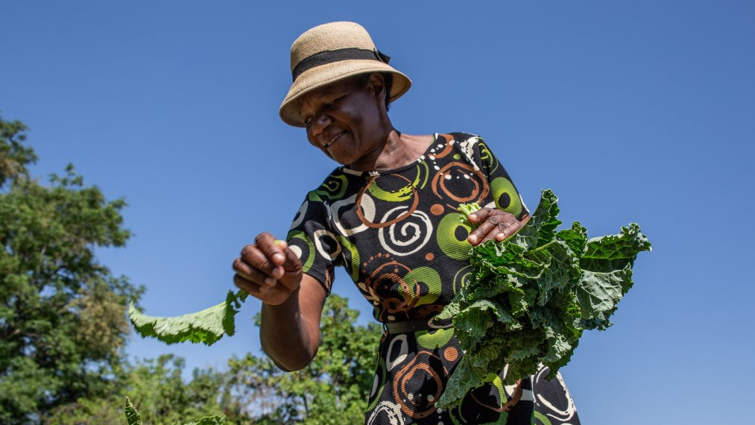


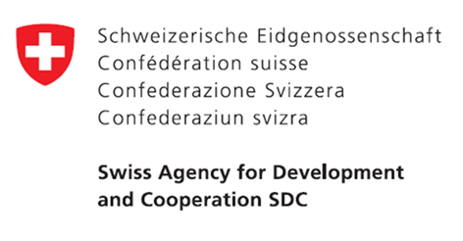
SUN Civil Society Network
Small Grants Programme 2024

Slide 2


What is the SUN CSN Small Grants Programme?
The SUN CSN Small Grants Programme, launched in 2018, aims to provide small grants to support Civil Society Alliances (CSAs) in piloting innovative research or projects. This funding is designed to build the capacity of local organisations interested in advancing research and innovative initiatives that can be scaled and shared as models of best practice for other CSAs within the global SUN CSN network. The Small Grants Programme is funded by UNOPS, Irish Aid and the Swiss Development Cooperation as part of their broader support to the SUN Civil Society Network Secretariat, hosted by Save the Children UK.

Slide 3
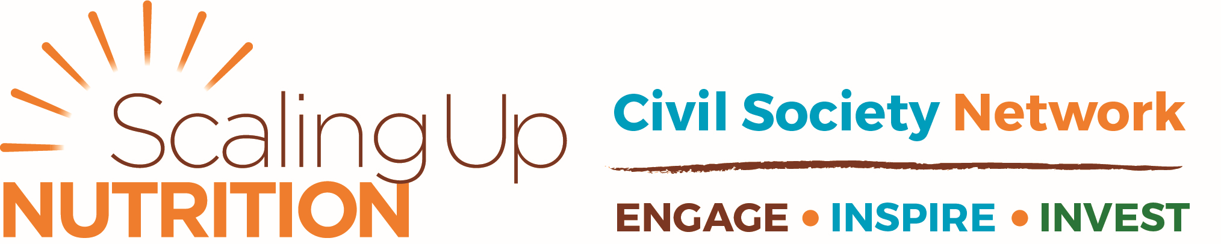

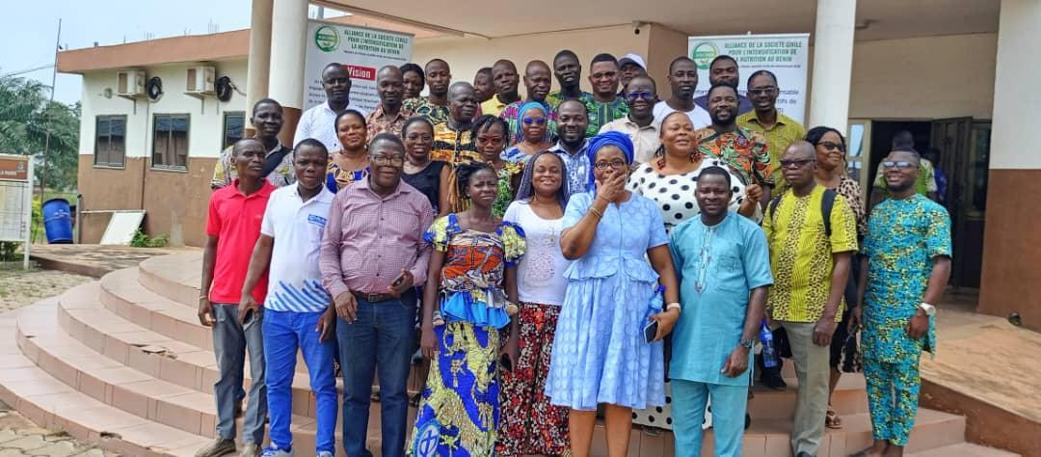
Bénin
Accountability for Nutrition Results in Benin Accountability for Nutrition Results (A4NR)
Achievements
The Accountability for Nutrition Results (A4NR) project, led by ASCINB, aimed to improve nutrition services in six Benin municipalities through social accountability. By involving local authorities, civil society, and communities via consultation frameworks (CCCs), the project promoted transparency, better planning, and stronger engagement around nutrition governance. They developed an Operational Guide to Nutrition Accountability (GOReN) for all civil society organizations.
Key achievements included the installation of boreholes and improved maternity care, drinking water points and the integration of nutrition into development plans. Community dialogues and radio programs raised awareness, while training strengthened the capacity of local actors and promoted better dietary practices.
​Despite challenges like limited project duration and gaps in funding, the project succeeded due to strong municipal leadership, NGO support, and community participation. Tools like Social Analysis and Action (ASA) also helped engage communities in identifying and solving nutrition issues.​
​
To sustain progress, the report recommends formalizing accountability tools, ensuring steady funding, and strengthening CCC coordination. The project demonstrates that social accountability can effectively improve nutrition services and local governance in Benin.

Slide 4


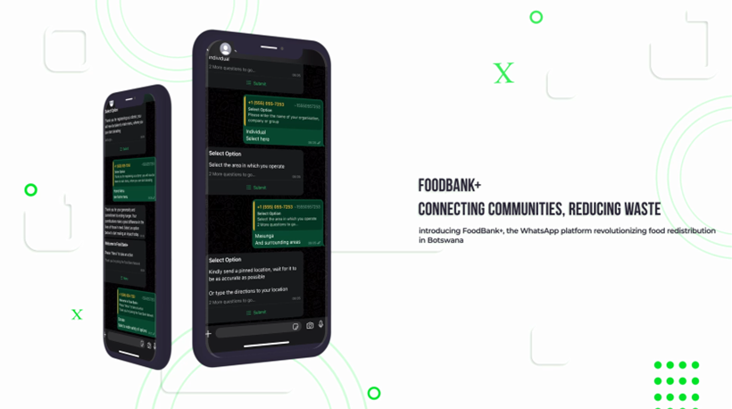
Botswana
Feeding Communities Together
Achievements
This project aimed to reduce food waste and improve household nutrition by connecting surplus food providers with vulnerable communities via a WhatsApp-based platform. The CSA developed a simple, digital system to enable real-time food redistribution, creating a scalable and sustainable solution.
Collaboration with agriculture, retail, civil society, and support from SUN Networks ensured alignment with national and global food security goals. Community leaders, charities, and transport partners played a key role in facilitating food deliveries and building local engagement.
The CSA is committed to sharing lessons learned through reports and workshops and plans to scale the project beyond Gaborone, introduce nutrition screening, and share the model with other countries and CSAs.
What set this initiative apart was its use of familiar, low-cost technology to remove logistical barriers and promote peer-to-peer sharing. By empowering communities and leveraging existing tools, the project not only addressed immediate food needs but also laid the groundwork for long-term, community-driven solutions

Slide 5

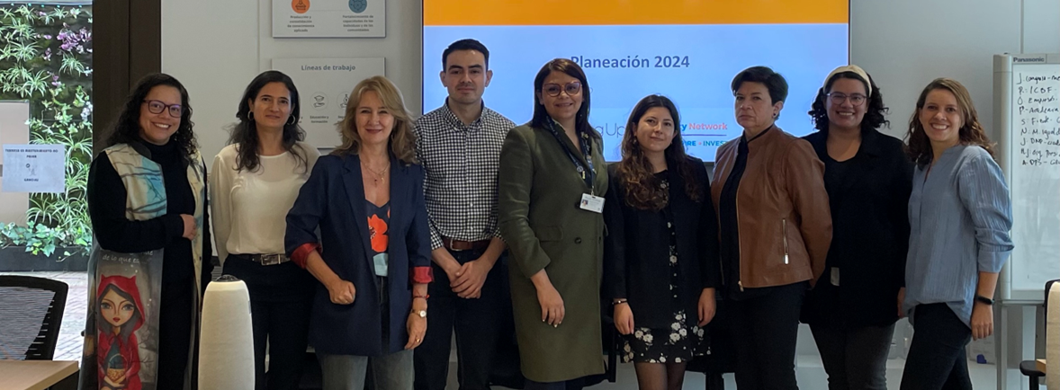
Colombia
Governance of the Civil Society Alliance (CSA) SUN Colombia
Achievements
The SUN Colombia CSA Governance Project significantly strengthened civil society’s role in national nutrition policy. A major achievement was the development of five core tools: the Governance Agreement, Advocacy Protocol, Financing Plan, Governance Methodology, and Communications and Branding Guide. These resources provide a strong framework for collaboration, transparency, and advocacy, enabling the CSA to operate more strategically and increase its influence in national nutrition and food security discussions.
The project established an inclusive, decentralized governance structure by engaging grassroots organizations through workshops and interviews, ensuring diverse voices in national policy dialogue. It also empowered local actors with practical tools, with strong potential to scale this model across Latin America and the Caribbean, enhancing its regional impact.
A key achievement is the project’s focus on sustainability, highlighted by a 2030 Financing Plan with a roadmap for diversified funding. Paired with a strong visual identity and communication strategy, the CSA is well-positioned to remain a leading voice in nutrition investment and policy reform.
The project has had a profound impact on the governance culture within the Colombian civil society landscape. The participatory process to develop the Governance Methodology and Advocacy Protocol has fostered trust, transparency, and shared commitment. These lessons offer a compelling model for other CSAs seeking to build sustainable, inclusive advocacy coalitions to advance food and nutrition rights.

Slide 6

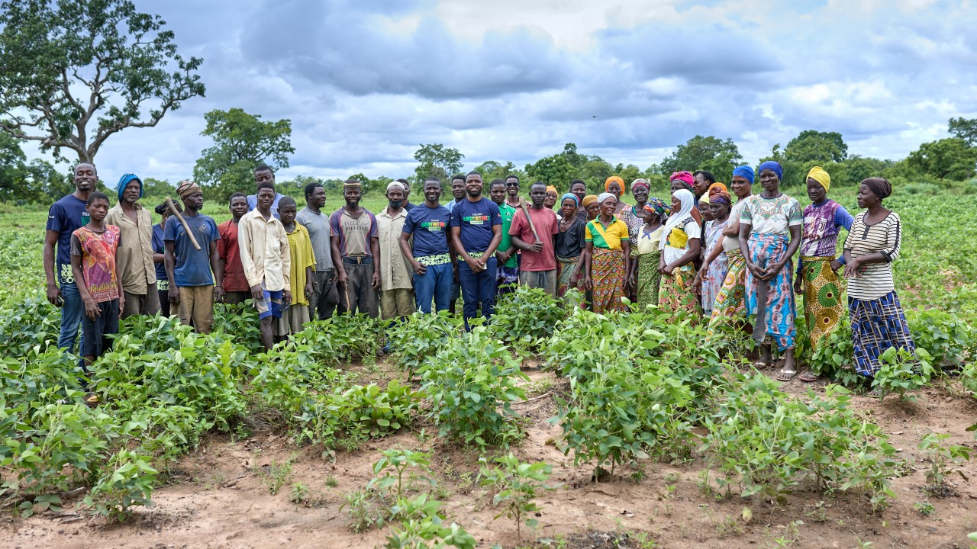
Ghana
Improving food system in Ghana through climate adaptation, mitigation and resilience in vulnerable communities in Denkyembour District.
Achievements
The project successfully built climate resilience among rural communities in Ghana’s Denkyembour District by promoting climate-smart agriculture and sustainable farming practices. Over 250 farmers received hands-on training, while targeted community forums (HERE & HERE), radio discussions and newsletters (HERE & HERE) raised widespread awareness of climate change, food security, and environmental sustainability.
A key achievement was the introduction and adoption of soya bean as a climate-resilient, soil-enriching crop. Demonstration farms were established, and over 150 farmers participated in orientation workshops, leading to increased interest in sustainable cultivation and improved yields.
The initiative empowered women, youth, and farmer groups through capacity-building, community engagement, and peer learning. Farmer cooperatives were formed to support knowledge exchange and ensure continuity, while local champions were identified to carry forward training and community mobilization beyond the project duration.​
​
The project’s influence extended beyond its original scope through radio outreach, strong collaboration with local institutions, and efforts to address illegal mining. With local structures now actively involved, demonstration farms operational, and environmental bylaws under discussion, the groundwork has been laid for lasting impact and replication in neighboring communities.

Slide 7

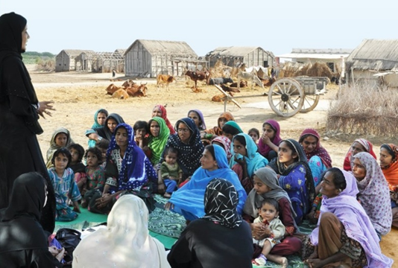
Pakistan
Enhancing Nutritional Accountability in Pakistan
Achievements
The project successfully enhanced grassroots participation in nutrition governance through targeted workshops and sensitization sessions. Over 200 community members and civil society actors were trained in advocacy, accountability, and public budget literacy. This fostered a culture of civic engagement, equipping communities in Balochistan, Punjab and Sindh with tools to monitor nutrition services.
Through strategic pre-budget advocacy and the N4G mobilization seminar, the initiative secured public commitments from Balochistan parliamentarians to increase funding for nutrition services. Key stakeholders, including finance officials and health departments, were engaged in dialogue on closing budget gaps. These efforts initiated a critical shift in political will and fiscal prioritization for nutrition.
​
The project introduced practical feedback systems, like suggestion boxes at Basic Health Units and public hearings. Creating structured platforms for communities to report issues. These mechanisms and a series of public hearings directly informed local authorities and led to improvements such as adjusted service hours and increased supply, demonstrating the power of community-led oversight.​
​
The project embedded accountability practices within local governance structures. Media campaigns reached over 30,000 people, while institutional capacity-building workshops strengthened CSOs across four provinces. By fostering collaboration across sectors and developing reusable advocacy materials, the initiative laid a scalable foundation for long-term impact on nutrition policy and practice in Pakistan. All the project documents are accessible on our official website www.youth.org.pk ​

Slide 8

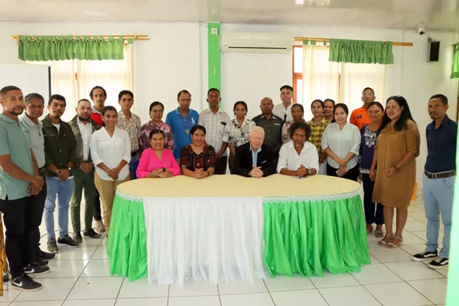
Timor-Leste
Establishment of SUN CSN Secretariat of Timor-Leste
Achievements
The project led to the establishment of the SUN CSN Secretariat in Timor-Leste, which marks a significant milestone in strengthening national coordination for nutrition advocacy and action. SUN CSN TL achieved full legal registration as Aliansa Sosiedade Civil ba Nutrisaun, unlocking eligibility for domestic funding and formal recognition by the government. The creation of a fully functional secretariat, staffed with a coordinator and finance officer, has transformed the network from an informal coalition into an operationally capable and nationally recognized entity. This transformation not only enhances coordination among the 26 member NGOs but also positions the network as a credible partner in advancing nutrition priorities across the country.
Stronger relationships with the government and the SUN Focal Point, is now enabling more effective alignment of civil society and government efforts.
The impact of this project extends beyond organizational strengthening. It has elevated civil society’s voice in national nutrition policy-making and program implementation. SUN CSN TL can now compete for diverse funding opportunities, implement nationwide programs, and participate as a recognized stakeholder in multi-sectoral nutrition platforms. The project has also reinforced collaboration between government entities, donors, and civil society, which is critical for achieving long-term progress in reducing malnutrition.

Slide 9

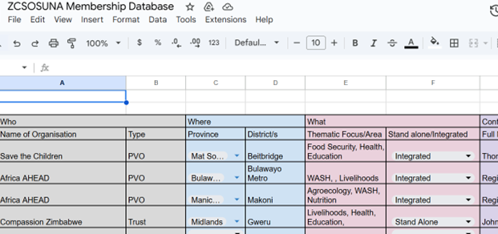
Zimbabwe
Strengthening national and sub national governance structures for meaningful representation and effective participation of civil society organisations in influencing scaling up of nutrition in Zimbabwe
Achievements
The project successfully revitalized Zimbabwe's national and sub-national governance structures. Through a hybrid gap analysis and mapping exercise, ZCSOSUNA identified active CSOs and addressed challenges stemming from post-COVID-19 disruptions and donor funding shifts. This exercise helped rebuild a functional, inclusive CSA, improved coordination among members, and set a foundation for increased citizen participation.
One of the major achievements was the convening of a steering committee, which led to the development of critical strategic documents, including a five-year strategic plan and a Prevention of Sexual Exploitation and Abuse policy. These enhanced the CSAs capacity for sustained advocacy, resource mobilization, and membership engagement.
​
At the provincial level, the project supported the hosting of multi-sectoral Food and Nutrition Security Committee meetings in four provinces, as well as a national civil society convening. These platforms facilitated meaningful discussions between CSOs and government sectors such as health, agriculture, education, and social protection. This multi-level engagement improved coordination, assessed CSO capacity, and reinforced alignment with national nutrition goals, ensuring that CSOs could complement government efforts more effectively.​
​
The project also championed child participation in national policy development through the Nutrition for Growth (N4G) Children’s Dialogue, which gathered student input from across the country. Their recommendations were formally submitted to the Food and Nutrition Council for policy consideration. Additionally, the development of a public, searchable CSO database and ongoing virtual data collection from remaining provinces will strengthen transparency, continuity, and future engagement. ​
​

