Slide 1
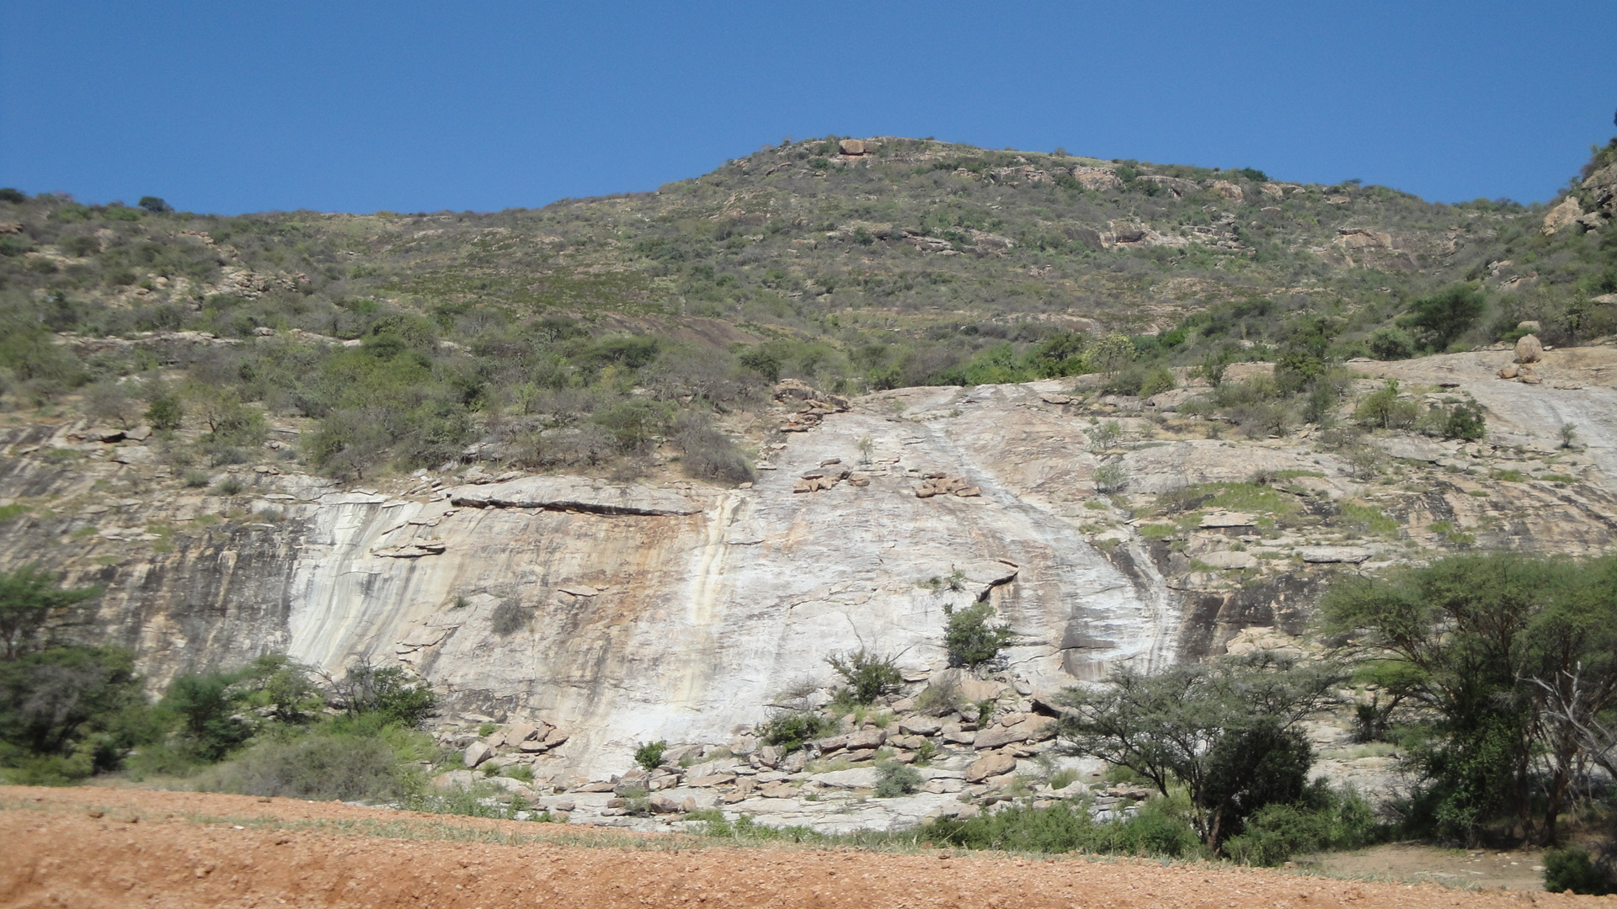
A QUIP study on Kajiado Adolescent Girls Campaign

Slide 2
Project Background.
FEED The Children (FEED) has been implementing adolescent nutrition campaign activities in Kajiado central subcounty, Kajiado county- Kenya.
The interventions have targeted in school and out of school adolescents-with nutrition messages and Life skills lessons Infused through Care Group approach and Nutrition Clubs in schools.
Through a phase funded by Sun CSA, FEED implemented a project aimed at being a mirror to reflect on the working, learnable and implementable Adolescent Nutrition Sensitive and specific strategies.

Slide 3
Objectives
Adolescent girls’ Project Objectives.
To reduce early and unintended pregnancy Among the adolescent girls.
To promote optimal nutrition for pregnant adolescents girls.
QUIP Study Objectives
To assess if the Kajiado Nutrition Campaign is achieving its intended objectives among the adolescent girls within the Oloilai ,Engaboli community Health Units( CHU) and 3 select schools within the same CHUs.

Slide 4
Research Questions.
1. Have there been any changes (positive or negative) in the respondents’ (In school and out of schoolgirls) lives over the past year and a half?
2. What do respondents perceive to be the drivers behind these changes?
3. Are these changes in any way linked to the Adolescent Girls Campaign, or incidental to it?

Slide 5
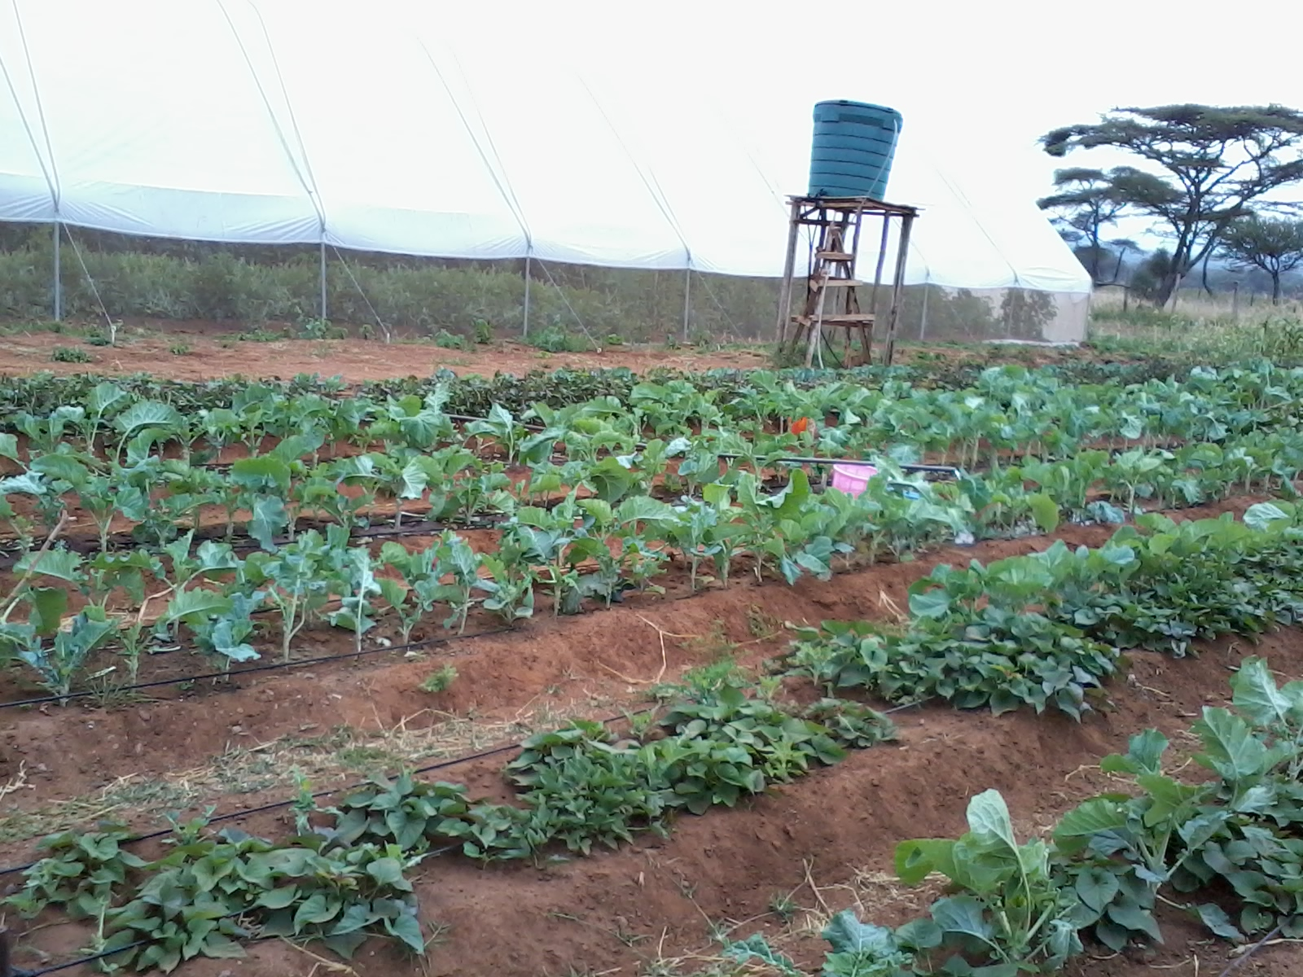
Domains of change.
A. To reduce early and unintended pregnancy among adolescent girls.
Reduced/ No early pregnancies
Extended years at school.
Improved school retention rates for adolescent girls.
B. To promote optimal nutrition for pregnant adolescents.
Optimal Nutrition status for pregnant adolescents
Consuming 5/10 food groups

Slide 6
Study Population
In school Adolescent girls.
Out of school Adolescent girls.

Slide 7
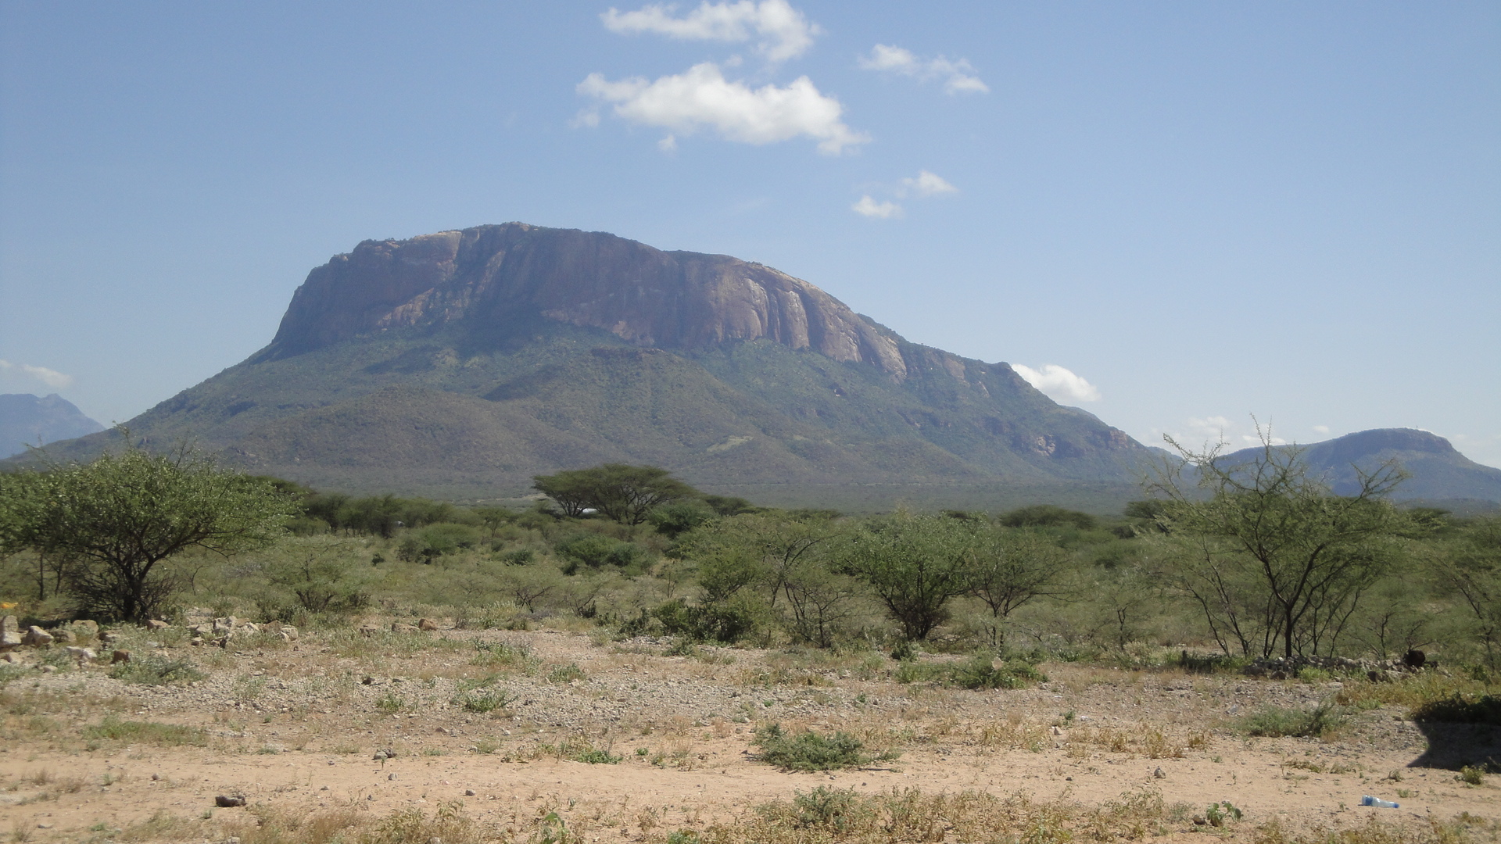
Methodology
A Qualitative Impact Assessment Protocol (QuIP) evaluation methodology was used to measure the impact of Campaign.
QuIP is a methodology considered to be a simple and cost-effective way to gather, analyze and present feedback from intended beneficiaries about significant drivers of change in their lives.
The QuIP gathers evidence of a project’s impact through narrative causal statements collected directly from intended project beneficiaries about significant drivers of change in their lives.
Respondents are asked to talk about the main changes in their lives over a pre-defined recall period and prompted to share what they perceive to be the main drivers of these changes., and to whom or what they attribute any change - which may well be from multiple sources.
QUIP’s primary objective is to explain variation in the wellbeing outcomes experienced by intended beneficiaries – not quantifying average effects.

Slide 8
Case selection strategy
Purposive Sampling.
24 semi-structured interviews and four focus group discussion were conducted in the local language (Kiswahili) by highly skilled, local researchers.
The research team conducting interviews were independent and blindfolded where appropriate.
Team had restricted knowledge about the project being evaluated. Respondents were also not aware of the intervention being evaluated.
Selected cases that captured as much variation in their responses.

Slide 9
Case selection for in schoolgirls applied two contextual variables based on age and school.
Two age categories were applied 10-14 years and 15-19 years.
In school-girls
School/age | 10-14 years years | 15-19 years
Mopia | 2 Respondents | 2 respondents
Inkati | 2 respondents | 2 respondents
Enoosaampurrmpurr | 2 respondents | 2 respondents

Slide 10
Out of school girls
Cluster of Villages where Caregroups are operational. | OLOILAI Community Health Unit | ENGABOLI Community Health Unit
Oloika/Mopia/Noositeti | 2 respondents | 1 respondent
Nentonai/ Ngatataek/Medanyi | 1 respondent | 1 respondent
Lositet/Oleisusua | 1 respondent | 1 respondent
Emukutan/ Enoosampurpur/Intialongoi | 1 respondent | 1 respondent
Enkidongoi/Mailitisa / engaboli | 1 respondent | 2 respondents
The case selection for out of school girls applied 2 contextual variables based on the Community Health Units (CHU) they came from and village clusters.

Slide 11
Out of school girls
Cluster of Villages where Caregroups are operational. | OLOILAI Community Health Unit | ENGABOLI Community Health Unit
Oloika/Mopia/Noositeti | 2 respondents | 1 respondent
Nentonai/ Ngatataek/Medanyi | 1 respondent | 1 respondent
Lositet/Oleisusua | 1 respondent | 1 respondent
Emukutan/ Enoosampurpur/Intialongoi | 1 respondent | 1 respondent
Enkidongoi/Mailitisa / engaboli | 1 respondent | 2 respondents
The case selection for out of school girls applied 2 contextual variables based on the Community Health Units (CHU) they came from and village clusters.

Slide 12
Focus Group Discussion
Church leaders.
Youth mentors/champions.
Teachers.
Allies.
Community Health Volunteers.
Case selection

Slide 13
Data Collection tools.
1. Semi structured household level questionnaire- Generative, opened ended questions and Supplementary questions.
Questions were framed around the outcome domains of change reflecting the broad areas of the lives of the respondents where we expected some change.
2. Focus group discussion guide.
Main aim being to elicit stories of change among the adolescent girls.
Sustain and deepen a conversation about changes observed.
Expose causal statements leading to root causes.

Slide 14
DATA ANALYSIS
Causal maps App was used for the analysis. Causal Map is a new online research tool, a way to code, analyze and visualize fragments of information about what causes what. It is a is a tool which helps social researchers and program evaluators to extract causal claims from texts (e.g., interview data) from different sources, and to combine and present it visually
Contact Steve on
steve@causalmap.app>

Slide 15
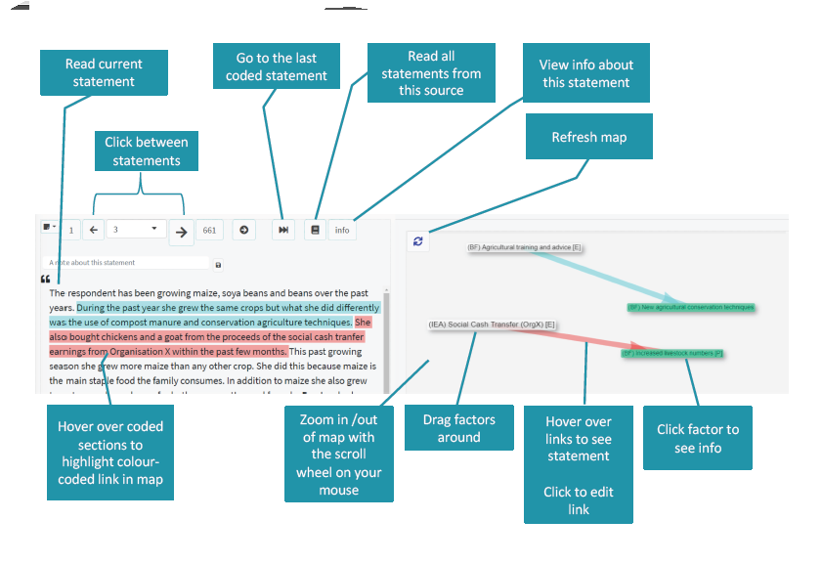
Data Analysis
Developing codes and cluster of codes to build up categories according to the stories of change shared by the respondents.
Cited Outcomes often become the drivers of change that can lead to other outcomes.
Thus helping to build causal claims and maps,

Slide 16
THEMATIC AREAS IN THE STUDY
Health and reproductive health issues.
Nutrition- Food consumption issues.
Household relations.
Community Relations.
External relations.

Slide 17
Survey findings

Slide 18
Interview dynamics
Key Highlights
Challenges
Interviews were undertaken to explore the direction of change in the different domains of the wellbeing of the adolescent girls in the past one and a halfyear.
Interviewing Adolescents was both interesting and intriguing with the dynamics of adult interviews shifting greatly.
Therefore, there was need for the researchers to build trust with the girls and allow even longer times of interviewing than what would be done in adult interviews.
In some cases, it was necessary to seek consent from both the respondent and the parent/husband.
In the Maasai community where the respondents were drawn, it is not unusual to find adolescent girls who are pregnant, mothers or married.
Community reacts with suspicion to any outsiders engaging the adolescent girls privately, because of the government child protection policies that may have been broken in those instances.
It is worth noting that the response rate was overwhelmingly good.

Slide 19
Food consumption and Availability The study sought to explore the drivers of change around the outcome on Food availability and its impact to the health of the adolescent girls.
1. Causal pathways in this study seemed to link food consumption, food availability, Food costs, livestock production, income and seasonality( drought) in a web.
+|+ had lost much weight but I have started regaining. This was as a result of insufficient food at home for the past year which resulted from the death of our livestock which are our main source of income. [Source: Ne-1-IS-18, statement: 724]
2. Above mentioned drivers affecting the food consumption habits of the adolescent girls in school and at home.
3. Therefore- need for a holistic approach to adolescent programing can not t be over emphasized.
4. Livestock was a key driver of change in food availability.
+|+Has changed This is because we get some from the market since the father sells domestic animals and he buys food. [Source: OL- 1-OS-1, statement: 170]
.

Slide 20
Food consumption and Availability- Other factors
Increased Nutrition knowledge to counter indigenous knowledge.
+|+The reason I have been getting a lot of foods varieties is because I was taught by health person (Jane) she taught me as an adolescent to take 5 or 10types of food a day and I don't practice much in school but I try at home because I get More varieties at home than in school. [Source: EN-2-IS-23, statement: 989]
Reliable sources of income.
+|+Sometimes money is not enough to buy sufficient food since the foods are very expensive in the market during such times. [Source: NE-2-IS-19, statement: 801]
Competing priorities in the household- Health needs.

Slide 21
Reduced food consumption- Influencing factors.
We sought to explore the drivers of change around nutrition.
We received both negative and positive changes mostly revolving around the vulnerability of the livelihoods in the community and the over reliance on livestock as a way of providing food to the households.
While the project anticipated that the girls would be a change agent in their household regarding decisions on food consumption, this community remains a patriarchal type and hence fathers make most of those decisions.
It may be worth exploring the need to involve adolescent boys in the adolescent campaigns to build future change agents in the homes and build more support for optimal food consumption at the household level.

Slide 22
Improved Food consumption habits. Factors driving the change stories
Showing numbers of links from and to each factor; factors are listed with most frequent first. You have 'show neighbours' switched on so this list may include factors which are not matched by your search filter.
Factor | to | from | total
Improved Food consumption | 38 | 1 | 39
Reduced food availability and consumption | 31 | 0 | 31
Eating more food varieties | 5 | 7 | 12
Eating balanced meals | 0 | 11 | 11
Reduced Food Purchases | 8 | 3 | 11
Consumption of more than 3 food groups | 0 | 10 | 10
Eats more food | 0 | 10 | 10
Eats varieties of food | 3 | 7 | 10
Respondents were consuming more food varieties indicated by the drivers presented on the table indicating this.
Citations.
+|+ Yes the food she eats has changed .she takes extra meals and different food groups for more production of milk. | Source: EG-5-OS-12 Statement: 4
+|+ Yes the food she eats has changed .she takes extra meals and different food groups for more production of milk. | Source: EG-5-OS-12 Statement:

Slide 23
Influencing factors to FC

Slide 24
Overall Wellbeing of the adolescent girls. This study sought to assess the perception of wellbeing of the adolescent girls. We received both positive and negative drivers of change. Some of the key drivers of negative change included the following:
Positive drivers.
+|+Wished to be a doctor since I had a desire on how they prime their duties of treating the sick Planning to go back to school to study and achieve the desire [Source: OL- 1-OS-2, statement: 257]
Peer Support Mechanisms.
Capacity Building for adolescents.
Guidance and counseling.
Birth of a child.
Marriage
Multi sectoral support to adolescent girls is inevitable towards improving their general wellbeing
Negative drivers.
+|+Emotionally demoralized when she dropped out of school due to pregnancy and she was bright in school, this made her loose hope Her classmates would finish school ahead of her Being the last bone in the house and the mother so much hopes in her [Source: OL-1-OS-3, statement: 311]
Teenage pregnancy.
School dropouts.
Shattered dreams.

Slide 25
Below is the map depicting the drivers of change affecting the overall wellbeing of the adolescent girls.
Overall Wellbeing of the adolescent girls

Slide 26
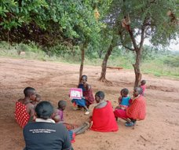
Household economic status.
The main drivers of change around the household economic status were found to revolve around the household’s ability to have a source of income either through Livestock or farming activities.
Through these activities the household can provide food for consumption. Other respondents shared that the surplus livestock and farm products would be sold to purchase food.
The respondents also viewed ownership of assets as a sign of improvement of the economic status in their families and this was also associated with provisions of food for the family.
On the flipside the girls shared Conflicts as being a cause of communication breakdown at home. This was seen to be an impediment to stability in economic status of the household. Below is a diagram to show the factors of change affecting household economic status.

Slide 27
Household economic status. Factors of change affecting household economic status

Slide 28
Improved Community Relationships
Improved community relationships | 0 | 22 | 22
Community assistance for adolescent girls to return to school | 2 | 0 | 2
Community education of importance of education | 2 | 0 | 2
Community interventions to curb school drop outs of adolescent girls | 2 | 0 | 2
Community interventions to making sanitary towels available | 2 | 0 | 2
people come together to support one another | 2 | 0 | 2
The study also sought to assess the perceptions of the girls regarding the community relationships facilitative to adolescent health.
This is because FEED uses Community focused approaches to promote behavior change. Some of the key drivers of change shared by the girls are summarized in the table.
While the in-school girls had less information regarding community organization towards adolescents’ girls. Both cohorts still shared that communities working together benefited the girls Education and health outcomes.

Slide 29
HOUSEHOLD HOLD RELATIONSHIPS
Household relationships were on two different fronts- For out of schoolgirls, the husband was a focal point of reference.
For the In school girls and those out of school but not married the Parents (Mother&Father) were the focal point.
Generally, not many of the adolescents were involved in decision making either by their husbands or by their parents.
In most of the cases, the males made majority of the decisions even on food consumption. While interventions were applied to adolescent girls, they had little or no role in decision making on food consumption in their homes.

Slide 30
Pregnancy and Child care
Under review were the changes that the adolescents (who are mothers) have experienced in Ante-natal and Post-natal care for themselves and in protecting the health of their babies. Consequential factors that were explored were:
Improved Health of the adolescent.
Improved emotional Health of the adolescent
Improved Reproductive Health
Improved health of the adolescent during pregnancy.
Adolescents' girls shared in changes attributed to knowledge which influenced the practices positively.
Many of the pregnant girls or mother adolescents improved their dietary practices so as to care for the own health and that of the baby

Slide 31
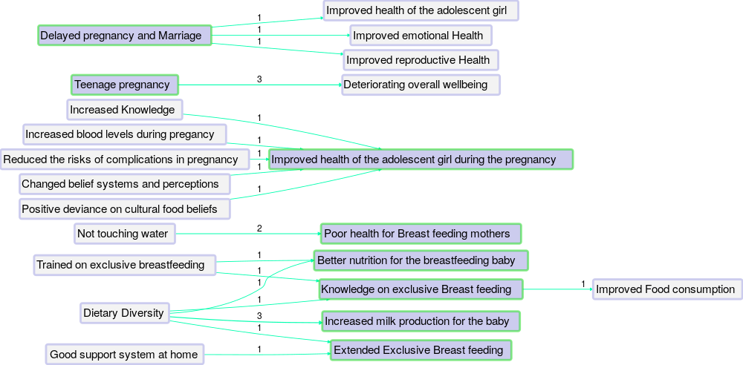

Slide 32
External Relationships Asked to name the most important external agencies to them, Feed the Children was the most named
Communita christian church | 4
Community groups | 2
Enkokidongoi | 3
Feed the children | 12
Girl child network | 2
Private Donor | 5
Religious groups | 1
School group | 3
World vision | 8

Slide 33
Reccomendations
Male involvement in adolescent interventions to build a pool of future adolescent girls champions.
A more integrated approach to adolescent health would be a better way to achieve the diverse needs of the girls. Health issues cannot be addressed in isolation from other sectoral needs.
The drivers of changes identified in this study, should inform the messages to be shared with adolescent girls in the next phase of the project.
Similarly, the content of the drivers shall inform the theory of change for the next phases of this project.
Partnership with Bath SDR was a big boost in this process of data coding. More solid partnerships should be developed in the next phase of the project.

