Slide 1
Conflicts & Disasters: How to Eliminate Hunger and Malnutrition in Difficult Times
Hilal Elver
UN Special Rapporteur on Right to Food

Slide 2
From 777m. to 815mil. 11% increase of hunger 1,5 m. children risk of death

Slide 3
Global cereal production historically high

Slide 5
State of Food Security Reports: FAO
Climate Change
Conflict

Slide 8
30 m. in North East Nigeria, South Sudan, Somalia, Yemen suffer from imminent famine
Notes:
10 March 2017 UN declared famine.
South Sudan. 5.5 million are severe food insecure.
North East Nigeria 5 m.
Somalia 6.7 m.

Slide 9
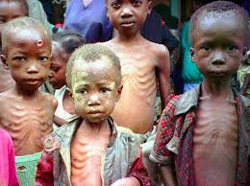
Malnutrition(Hidden hunger)
2 billion suffer from undernutrition, and micronutrient deficiency
1.9 billion are overweight and obese;
5 to 6 million children die every year from malnutrition and related diseases;
161 million under 5 stunted ( 51 mil), & wasted ( 42 mil);
Notes:
45% in Pakistan underfed, chronically malnourished, 11% Acutely malnourished (UNESCO report)
1 in every 14 dies before age of 1.
1 in 11 under 5.
6.7 million out of school, 55% are girls.

Slide 10
Yemen: War & Famine
Notes:
Some 17 million Yemenis — 60 per cent of the population — are food insecure, while 7 million are at risk of famine and acute food insecurity.
Kolera outbreak

Slide 11
Syria: 13 Million needs food, water, medicine
Notes:
Beyond these four particularly serious situations, some 70 million people in 45 countries currently require emergency food assistance, an increase of 40 per cent from 2015.2 Most of these countries are suffering from protracted crises or are in post-conflict situations.

Slide 12
Deliberate famine is crimes against humanity: Rohingya

Slide 13
Hunger + War =Migration Europe’s biggest problem

Slide 14
Misery for refugee women& girls on Greek islands
Notes:
Government Downplays Sexual Violence Risks in Migrant Hotspots

Slide 15
Winter conditions bring starvation and sickness

Slide 16
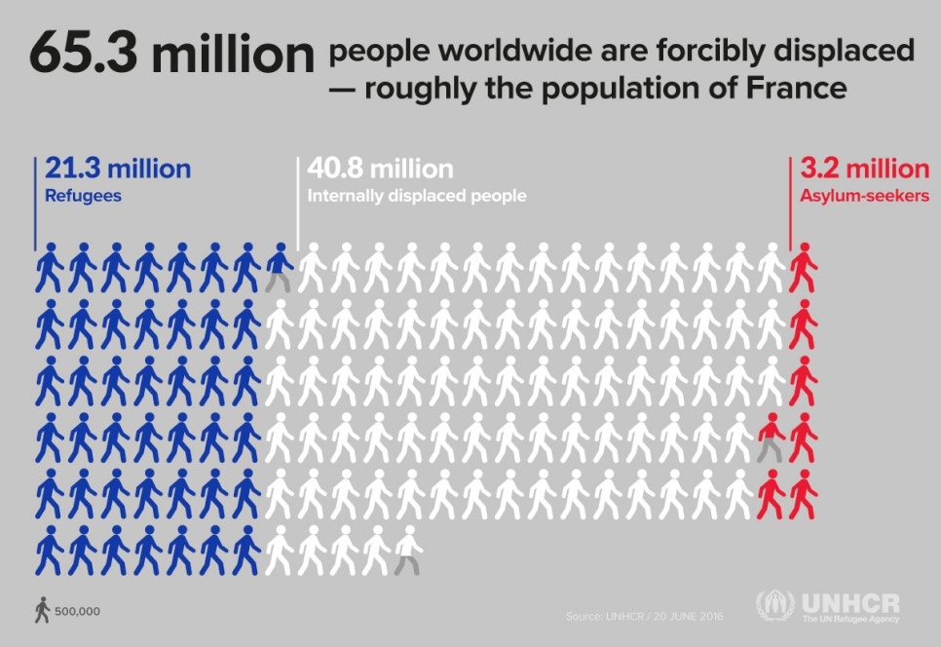

Slide 17
Extreme Weather Events: Drought & Flood

Slide 18
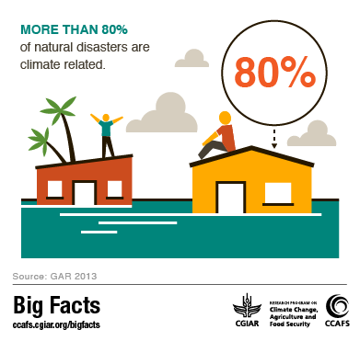

Slide 19
Women and children are the most vulnerable

Slide 20
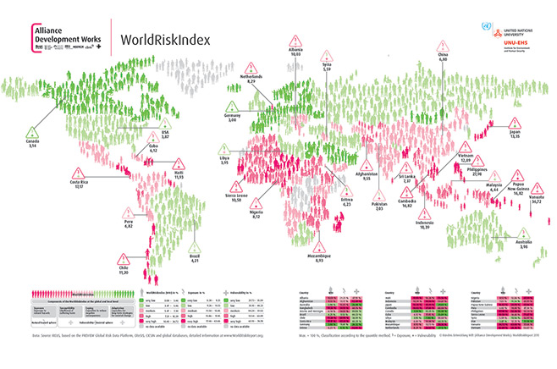

Slide 21
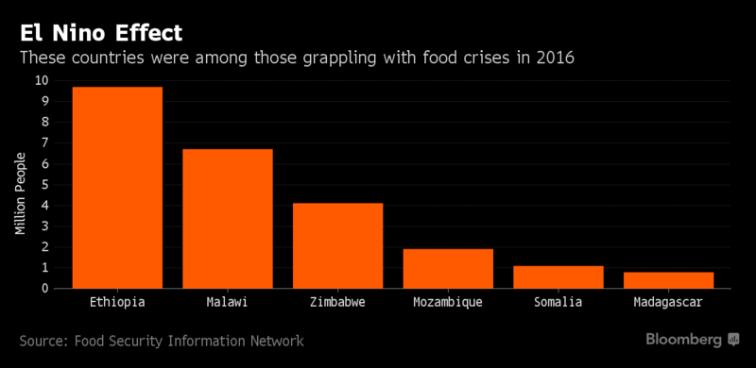
Notes:
Number of people facing food insecurity rose 35% last year. Hunger expected to worsen in locations Yemen and Nigeria, as staple food prices have risen to a record high.

Slide 22
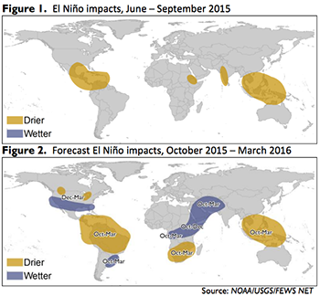

Slide 23
Texas: Hurricane Harvey

Slide 24
Florida: Hurricane Irma

Slide 25
Puerto Rico: Hurricane Irma, then Maria

Slide 26
80 % infrastructure gone

Slide 27
January 9, 2018 CA. Highway 101

Slide 28
January 21. 2018 CA. Highway 101

Slide 29
Legal Structure: State obligation& International responsibility
International Human Rights Law: War and peace time; (UDHCR, CESCR)
International Humanitarian Law: War time
International Criminal Law; Individual Responsibility ( Rome Statute of the ICC)
International Disaster Law:
Climate Change Law ( UNFCCC): Green Fund
Food Aid Convention: FAC 2012

Slide 30
Emergency Food Aid & Food Assistance

Slide 31
Overseas Development Assistance (ODA)
Notes:
50% of food aid comes from the USA.

Slide 32
Foreign Aid: Percentage of GNI

Slide 33
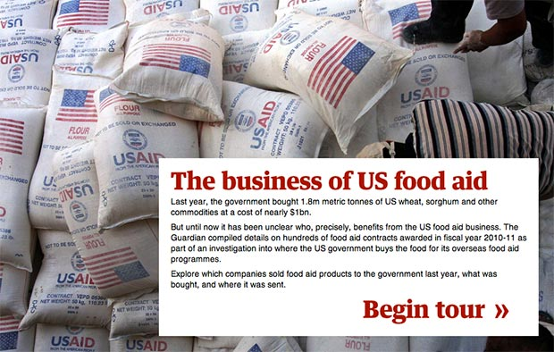
Notes:
1 billion US$ was spend US in kind food aid wheat, sorgum. ( Data: Guardian, 18 July, 2012)

Slide 34
How food aid goes? Food aid or corporate welfare?

Slide 35
Reforming humanitarianism
From charity and voluntarism to legal obligation
Coordination: States, IO, NGOs, Private Sector
Human rights approach;
Accountability for all;
More flexible, less earmarked;
Greater local ownership;
Solving funding gap: Innovative solution

Slide 36
Reform of the food assistance
Convergence of emergency with development: than includes pre., during and post disaster remedies ( infrastructure investment);
Holistic approach: Climate justice, migration and other global problems;
Right to food is collective rights as well as individual
Introduce food sovereignty instead of industrial agriculture
Strong gender perspective as they are the agent of change

Slide 37
Gender equality: A global issue; Gender gap is widening

Slide 38
CEDAW General Recommendation #34 on rural women

Slide 39
Rural Women: 25%, 60-70% are farmers, 43% agric. labors
Notes:
if women had the same access to resources as male farmers, they could lift 100-150 million people out of hunger.
CLIMATA POLICIES: Gender disaggregated data.

Slide 40
If women access to resources… 100-150 m. will not be hungry
Notes:
. if women had the same access to resources as male farmers, they could lift 100-150 million people out of hunger.

Slide 41
Legal Barriers

Slide 42
Access to market: Do they have time? Waged v. contractual farming
Notes:
Waged versus contractual farming: 450 million waged workers, 20-30% are women, 30 % are in fishing sector

Slide 43
Female Food chain workers: 43% ag. workers, in LDC 79%; 2/3 livestock keepers
Notes:
43% of agricultural worker
2/3 of the world’s 600,000 poor livestock keepers
Least developed countries 79% women are in agriculture

Slide 44
Occupational Segregation
Unpaid jobs: Care
Women participation to work force 40% as opposed to 70%;
Women earn 24 % less then men;
Less paid jobs, seasonal, part time jobs for women;
Male farmworkers make an estimated $16,250 a year and female ones $11,250 a year in the US.

Slide 45
Economic Barriers: Gender gap
Trade liberalization: Big scale industrial agriculture excludes women;
Mono-cropping;
Land grabbing;
Cash crops v. local production;
Access to credit;
Agro-biotechnology ( Seed- GE);

Slide 46
Female Farmworkers and sexual violence
Notes:
Cultivating Fear, Human Rights Watch 2012
Male farmworkers make an estimated $16,250 a year and female ones $11,250 a year.

Slide 47
Pesticide Exposure: biggest victim women and children

